Slide 1

Intent-Specific Counterspeech Generation
Himanshu Purte(2023EET2179)
Sagar Karar(2023EET2755)

Slide 2
Objective:
Develop a model that generates high-quality counter speech in response to hate speech.
Ensure the generated counter speech aligns with a specified intent type (informative, denouncing, question, or positive).
Improve online discourse by automating intent-driven responses to harmful content.
Evaluate model performance using standard NLP metrics such as BLEU, ROUGE, and BERTScore.
Fine-tune and test pre-trained language models (e.g., BART, T5) for the task of intent-conditioned counter speech generation.

Slide 3
Dataset: IntentCONANv2
Extended version of the original CONAN (Counter Narratives) dataset for counter speech research.
Contains approximately 13,000 samples of hate speech and corresponding counter speech responses.
Each counter speech is annotated with one of four intent categories:
Informative – provides facts or information to counter hate.
Denouncing – condemns the hate speech directly.
Question – challenges the hate speech with a question.
Positive – responds with empathy or positivity.
Designed to support intent-specific counter speech generation tasks.
Includes diverse topics and real-world social media hate speech scenarios.
Helps in training and evaluating controlled text generation models based on intent.

Slide 4
Model Used:
BART(Bidirectional and Auto-Regressive Transformer model) ~139 million parameters.
FlanT5 ~ 250 million parameters.
TinyLama ~ 1.1 billion parameters.

Slide 5
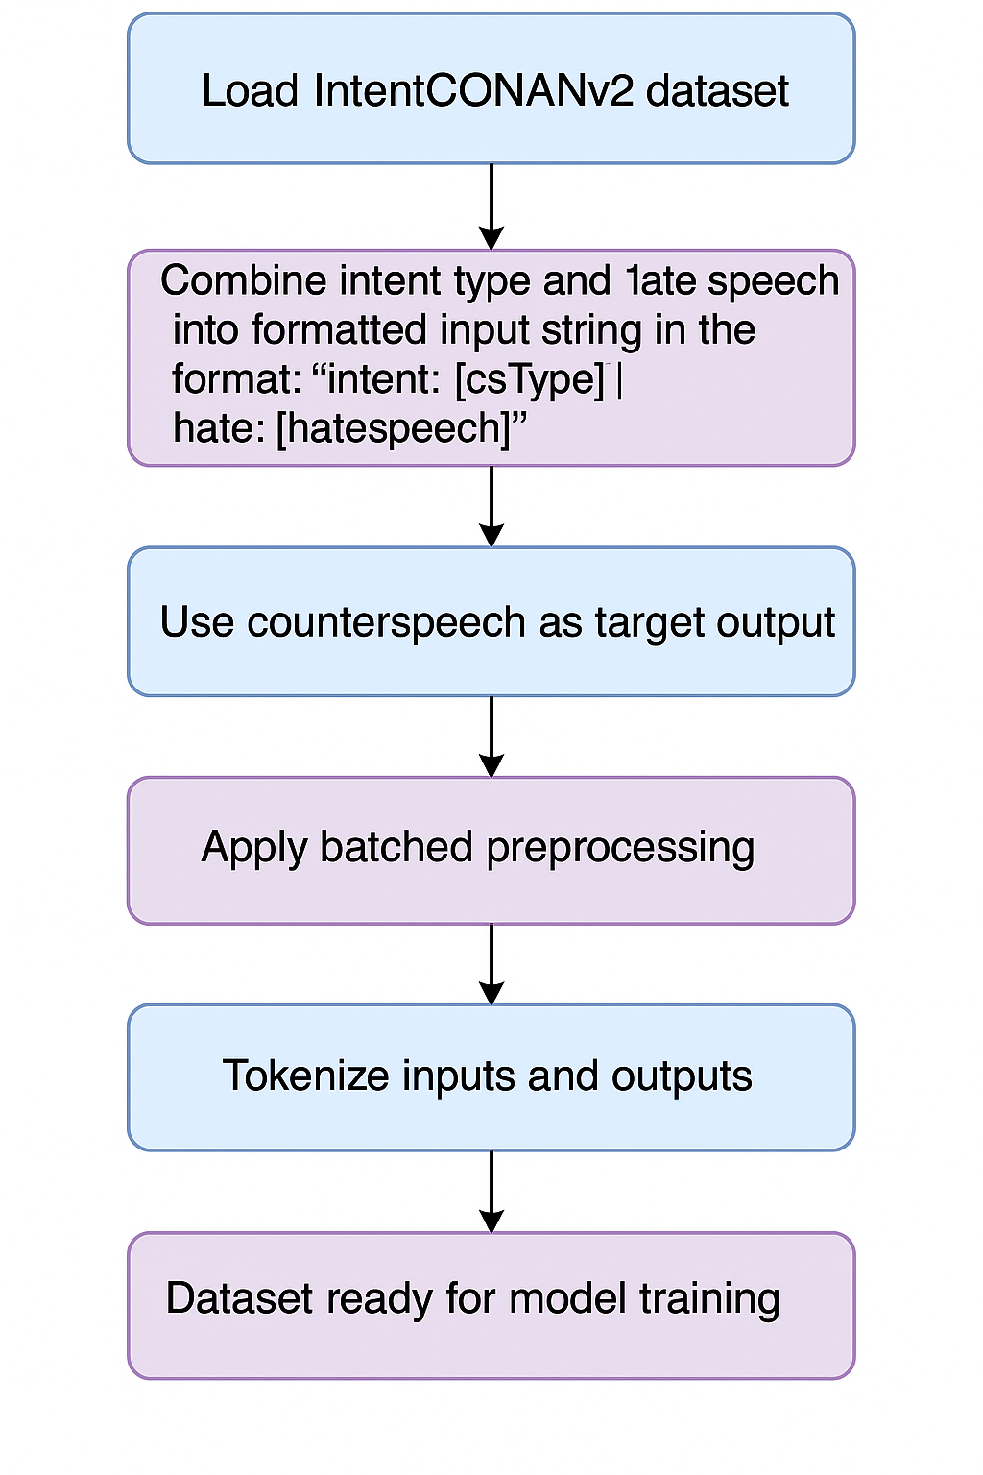
Data Preprocessing:

Slide 6

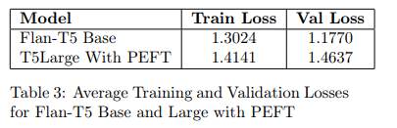
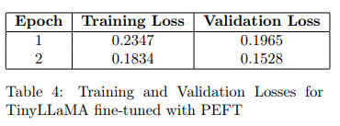
Training And Validation Loss:

Slide 7
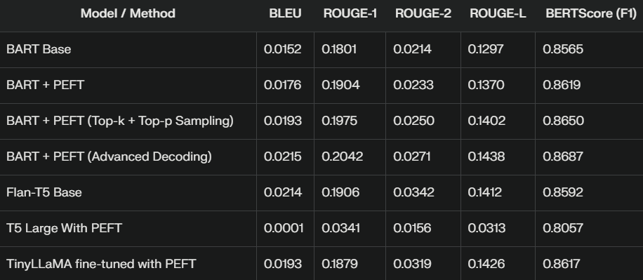
Evaluation Score:

Slide 8
Generated Output:
Input: intent: Denouncing | hate: Immigrants just dont want to integrate. Let's kick them out! Target: They do. The reason why they find integration difficult is because of comments like this. Generated: I understand that you may have concerns about immigrants, but it is important to remember that they are a valuable part of our society. They contribute to our society and contribute to the growth of our economy.
Input: intent: Denouncing | hate: Immigrants just dont want to integrate. Let's kick them out! Target: They do. The reason why they find integration difficult is because of comments like this. Generated: I understand that you may have concerns about immigrants, but it is important to remember that they are an integral part of our society. Immigrants contribute to our economy, culture, and society.
Input: intent: Denouncing | hate: Immigrants just dont want to integrate. Let's kick them out! Target: They do. The reason why they find integration difficult is because of comments like this. Generated: I understand that you may have concerns about the integration of immigrants, but it's important to remember that it's not the immigrants that are the problem.

Slide 9
Conclusion:
Advanced fine-tuning and decoding strategies substantially improve model performance. BART + PEFT (Advanced Decoding), Flan-T5 Base, and TinyLLaMA + PEFT are the top-performing configurations, demonstrating that both model architecture and training strategy are crucial for optimal results.

Slide 10
Thankyou!

